Slide 1
Data Structure and Algorithm CSE-225 Lecture-15

Slide 2
Graph
Terminology
Sequential Representation of Graphs: Adjacency Matrix, Path Matrix
Warshall’s Algorithm (Path Matrix)
Shortest Path
Graph Traversal
Breath First Search (BFS)
Depth First Search (DFS)
Spanning Tree
Minimum Spanning Tree
Kruskal Algorithm
Prime’s Algorithm

Slide 3
Graph
A graph is a collection of nodes (or vertices) and edges (or arcs)
Each node contains an element
Each edge connects two nodes together (or possibly the same node to itself) and may contain an edge attribute
A directed graph is one in which the edges have a direction
An undirected graph is one in which the
edges do not have a direction

Slide 4
What is a Graph?
A graph G = (V,E) is composed of:
V: set of vertices
E: set of edges connecting the vertices in V
An edge e = (u,v) is a pair of vertices
Example:
a
b
V= {a,b,c,d,e}
E= {(a,b),(a,c),(a,d),
(b,e),(c,d),(c,e), (d,e)}
c
d
e

Slide 5
Some problems that can be
represented by a graph
computer networks
airline flights
road map
course prerequisite structure
tasks for completing a job
flow of control through a program
many more

Slide 6
a digraph
A
B
E
C
D
V = [A, B, C, D, E]
E = [<A,B>, <B,C>, <C,B>, <A,C>, <A,E>, <C,D>]

Slide 7
Graph terminology
The size of a graph is the number of nodes in it
The empty graph has size zero (no nodes)
If two nodes are connected by an edge, they are neighbors (and the nodes are adjacent to each other)
The degree of a node is the number of edges it has
For directed graphs,
If a directed edge goes from node S to node D, we call S the source and D the destination of the edge
The edge is an out-edge of S and an in-edge of D
S is a predecessor of D, and D is a successor of S
The in-degree of a node is the number of in-edges it has
The out-degree of a node is the number of out-edges it has
6

Slide 8
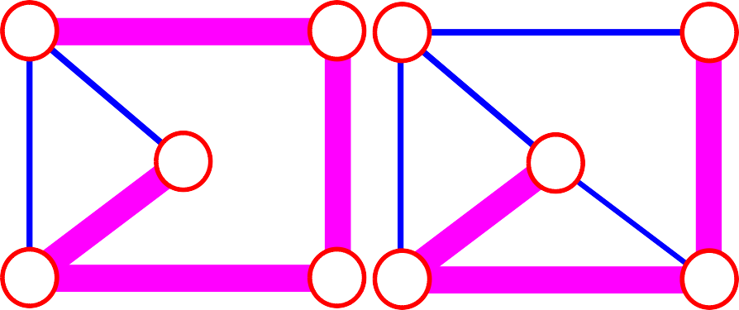
Terminology:
path: sequence of vertices v₁,v₂,. . .v_{k} such that consecutive vertices v_{i} and v_{i+1} are adjacent.
3
2
3
3
3
a
b
a
b
c
c
d
e
d
e
a b e d c
b e d c
7

Slide 9



More Terminology
simple path:
no repeated vertices
a b
b e c
c
d
e
cycle:
simple path, except that the last vertex is the same
as the first vertex
a b
a
a c d a
c
d
e

Slide 10
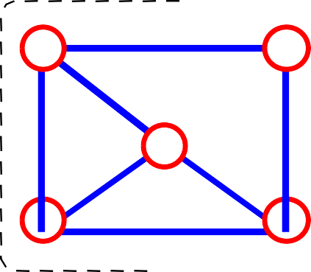
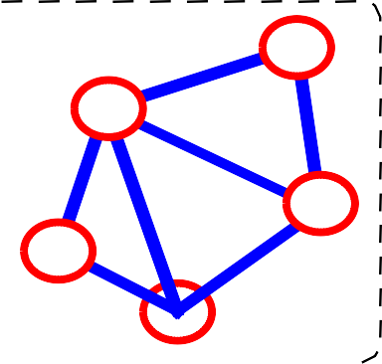
Even More Terminology
•connected graph: any two vertices are connected by some path
connected not connected
subgraph: subset of vertices and edges forming a graph
connected component: maximal connected subgraph. E.g., the graph below has 3 connected components.

Slide 11
Subgraphs Examples
0
0 0 1
2
0
1
2
1
2
3
1
2
3
G1
0
(i)
(ii) (iii) (iv)
(a) Some of the subgraph of G₁
3
0
0
0
0
1
1
1
1
2
2
(iii)
2
(i)
(ii)
(iv)
G3
(b) Some of the subgraph of G₃

Slide 12









More…
tree - connected graph without cycles
forest - collection of trees
tree
tree
forest
tree
tree

Slide 13
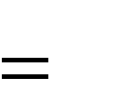
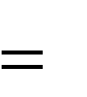
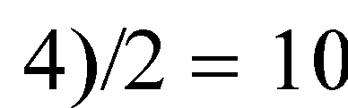

Connectivity
Let n = #vertices, and m = #edges
A complete graph: one in which all pairs of vertices
are adjacent
How many total edges in a complete graph?
– Each of the n vertices is incident to n-1 edges, however, we would have counted each edge twice!
Therefore, intuitively, m = n(n -1)/2.
Therefore, if a graph is not complete, m < n(n -1)/2
n 5
m (5

Slide 14
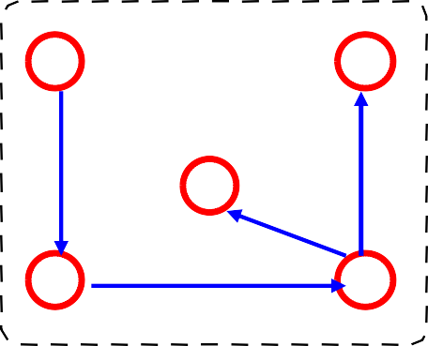
Directed (Oriented ) Graph
A graph where edges are directed

Slide 15
Directed vs. Undirected Graph
An undirected graph is one in which the pair of vertices in a edge is unordered,
(v0, v1) = (v1,v0)
A directed graph is one in which each
edge is a directed pair of vertices, <v0,
v1> != <v1,v0>
tail
head

Slide 16
Graph terminology
An undirected graph is connected if there is a path from every node to every other node
A directed graph is strongly connected if there is a path from
every node to every other node
A directed graph is weakly connected if the underlying undirected graph is connected
Node X is reachable from node Y if there is a path from Y to X
A subset of the nodes of the graph is a connected component (or just a component) if there is a path from every node in the subset to every other node in the subset
16

Slide 17
Graph data structures
storing the vertices
each vertex has a unique identifier and, maybe, other information
for efficiency, associate each vertex with a number that can be used as an index
storing the edges
adjacency matrix – represent all possible edges
adjacency lists – represent only the existing edges

Slide 18
storing the vertices
when a vertex is added to the graph,
assign it a number
vertices are numbered between 0 and n-1
graph operations start by looking up the number associated with a vertex
many data structures to use
any of the associative data structures
for small graphs a vector can be used
search will be O(n)

Slide 19
the vertex vector
0
A
1
B
4
E
A
B
C D E
0
1
2
3
4
C
2
D
3

Slide 20
adjacency matrix
0
1
2
3
4
A B
C
D E
0
A
1
B
4
E
0 1 2 3 4
0
1
2
3
4
0 | 1 | 1 | 0 | 1
0 | 0 | 1 | 0 | 0
0 | 1 | 0 | 1 | 0
0 | 0 | 0 | 0 | 0
0 | 0 | 0 | 0 | 0
C
2
D
3

Slide 21


Examples for Adjacency Matrix
0
0
1
2
1
3
G2
G1
2
0 1 0
1 0 1
0 0 0
0 1 1 1
1 0 1 1
1 1 0 1
1 1 1 0
Asymmetric
symmetric

Slide 22
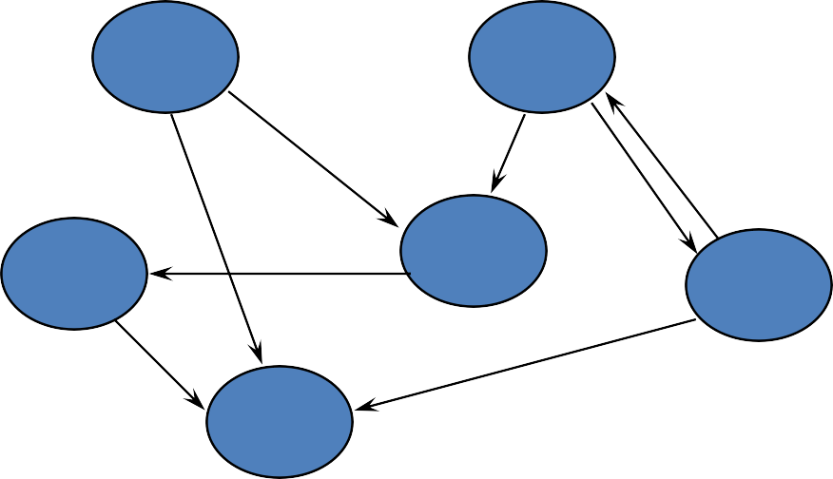
maximum # edges?
a V² matrix is needed for
a graph with V vertices

Slide 23
Many graphs are “sparse”
degree of “sparseness” key factor in
choosing a data structure for edges
adjacency matrix requires space for all possible edges
adjacency list requires space for existing
edges only
affects amount of memory space needed
affects efficiency of graph operations

Slide 24
adjacency lists
0
A
0
1
2
3
4
A
B
C D E
1
B
4
E
C
2
D
3
0
1
2
3
4
1
2
4
2
1
3

Slide 25
0
1
2
3
0
1
2
3
1
2
3
0
2
3
0
1
3
0
1
2
G1
0
0
1
2
1
0
2
1
G3
2

Slide 26
Least-Cost Algorithms
Dijkstra’s Algorithm
Find the least cost path from a given node to all
other nodes in the network
N = Set of nodes in the network
s = Source node
M = Set of nodes so far incorporated by the algorithm
d_{ij} = link cost from node i to node j,
d_{ii} = 0
d_{ij} =
∞ if two nodes are not directly connected
^{d}ij
>= 0 of two nodes are directly connected
D_{n}
= cost of the least-cost path from node s to
node n that is currently known to the algorithm

Slide 27
1. Initialize
M = {s} [ set of nodes so far incorporated consists of only the source node]
d_{n}= d_{sn} for n != s (initial path costs to the neighbor nodes are simply the link cost)
2. Find the neighbor node not in M that has the least-cost path from node s and incorporate that node into M.

Slide 28
3. Find w !Є M such that D_{w}= min { D_{j} } for j
!Є M
4. Update the least-cost path:
D_{n} = min[ D_{n} , D_{w} + d_{wn} ] for all n !Є M
5. If the latter term is minimum, path from s to n is now the path from s to w, concatenated with the link from w to n

Slide 29
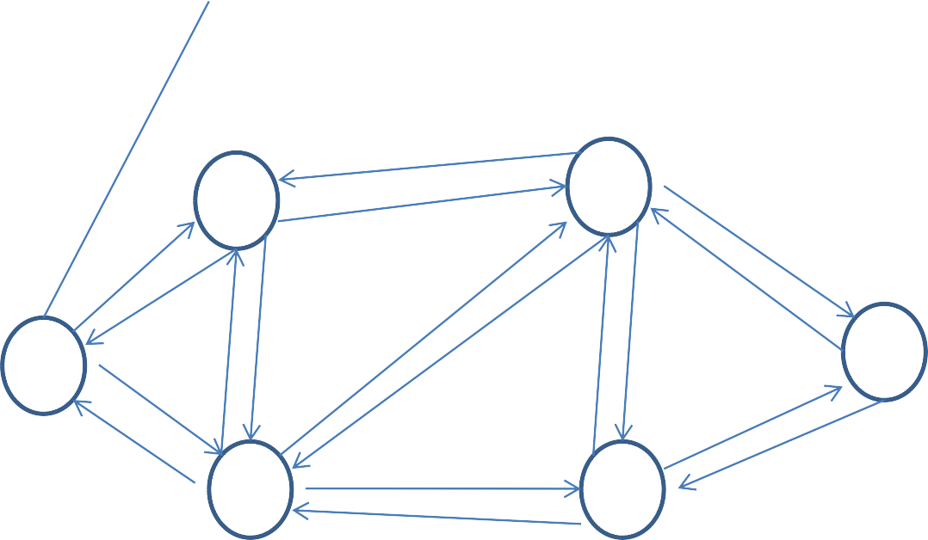
8
5
6
2
3
8
2
3
3
1
3
1
5
2
2
6
1
7 4
4
5
1

Slide 30
It = Iteration
It M | D₂ Path | D₃ Path | D₄ Path | D₅ Path | D₆ | Path
1 {1} | 2 1 -2 | 5 1-3 | 1 1-4 | ∞ - | ∞ | -
2 {1, 4} | 2 1-2 | 4 1-4-3 | 1 1-4 | 2 1-4-5 | ∞ | -
3 {1,2,4} | 2 1-2 | 4 1-4-3 | 1 1-4 | 2 1-4-5 | ∞ | -

Slide 31
Bellman-Ford Algorithm
s = Source node
^{d}ij
= link from node i to j
h = maximum number of links in a path at the current stage of the algorithm
_{Dn} (h)
= cost of the least cost path from
node s to node n under the constraint of no more than h links

Slide 32
Algorithm
1. Initialize
(0)
D_{n} = ∞ for all n != s
D_{s} = 0 for all h
(h)
2. For each successive h >= 0
(h+1) (h)
D_{n} = Min_{j} [D_{j} + d_{jn} ]
The path from s to i terminates with the link from j to i
[Step 2 is repeated until none of the cost changes]

Slide 33
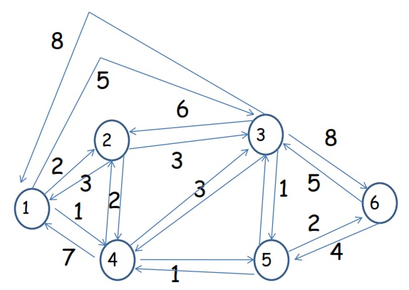

Slide 34
h | D₂^{(h)} path | D₃^{(h)} path | D₄^{(h)} path | D₅^{(h)} path | D₆^{(h)} path
0 | ∞ - | ∞ - | ∞ - | ∞ - | ∞ -
1 | 2 1-2 | 5 1-3 | 1 1-4 | ∞ - | ∞ -
2 | 2 1-2 | 4 1-4-3 | 1 1-4 | 2 1-4-5 | ∞ -
3 | 2 1-2 | 3 1-4-5-3 | 1 1-4 | 2 1-4-5 | 4 1-4-5- 6
4 | 2 1-2 | 3 1-4-5-3 | 1 1-4 | 2 1-4-5 | 4 1-4-5- 6

